Slide 1
This is a test
What the fuck!

Slide 2
demo
To read a word document we take help of the module named docx. We first install docx as shown below. Then write a program to use the different functions in docx module to read the entire file by paragraphs.

Slide 3
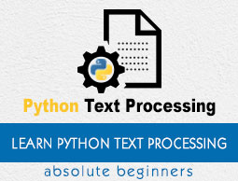
Image

Slide 4
Gif

Slide 5

PNG

Slide 6

Video

Slide 7


Slide 8


